Slide 1
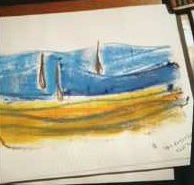
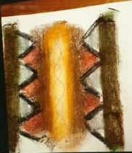
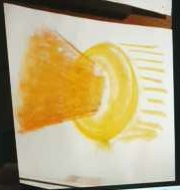
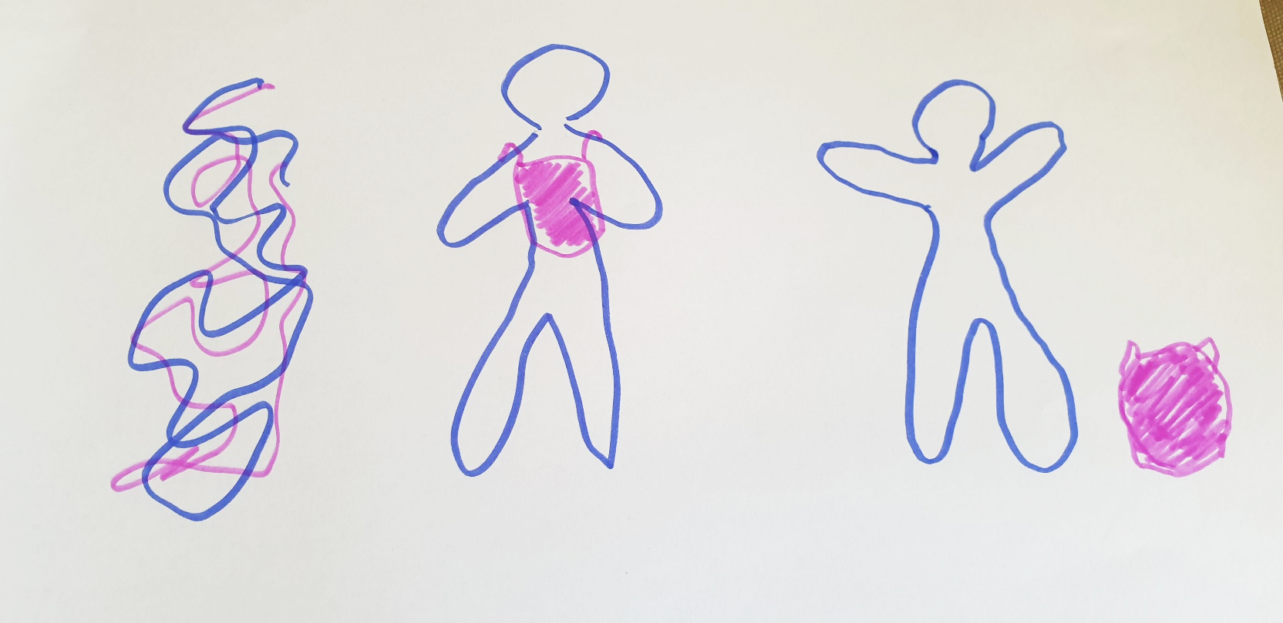
Crystallise Your Essence
A Culture Shift is needed to include Art Therapy in the Clinical Treatment of Mental Health Issues
Adopt Art Therapy for the Benefit of Your Patients
BENEFITS of art therapy TO CLINICIANS
Provides a different perspective
Enhances treatment planning
Complements traditional therapy approaches
Addresses underlying trauma and emotions
Provides visual imagery repeated re-telling of their story
Recommended Actions for CULTURE CHANGE
Become knowledgeable and supportive of the validity of art therapy
Motivate colleagues to include art therapy in multidisciplinary teams
Reinforce with patients that it’s an important approach to healing
Appreciate art therapy’s therapeutic aspect, different to a diversional therapy
Crystallise Your Essence
Examples of how art therapy works in collaboration
Emotional Pain
Anxiety and Anger
“A portal”
A person suffering anxiety moves from a description of emotional pain, to an exploration of the anxiety and anger behind it, then into a space of seeing both into and out of their predicament. This change in perspective was helpful with processing the emotions involved with their psychologist.
All-consuming identity to a manageable one
A person with a diagnosis of bipolar affective disorder was able to extract that identity and see themselves as a whole person, with the illness being an add-on that is only active during an episode of the illness. This insight assisted collaborative discussion with their psychiatrist and re-evaluation of their medication regime.
CONCLUSION
Although there needs to be more rigorous and larger scale research into the efficacy of art therapy, there is mounting evidence that it would be a great benefit to multidisciplinary teams in treating the whole person.
Authors
Eileen Jenkins,
Transpersonal Art Therapist
Dr May Su, Academic GP
Crystallise Your Essence
Acknowledgments
Thanks to Prof Marilyn McMurchie for the inspiration to produce this poster and to Joanna Schultz and Owen Jenkins for their invaluable assistance.
Thank you to the individuals who provided consent for their images and stories to be shared.

